Slide 1

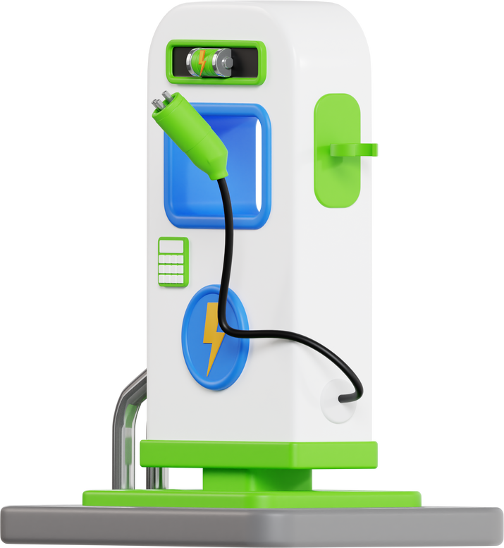
Join us on May 14th, 2024 for
Benchmark YYC and EV Charging Pilot Program
7:00pm - 8:30pm on Zoom
Join us for a fascinating online event where we'll discuss:
  How to participate in BenchmarkYYC and the associated benefits
  How they can access the EV Charging Pilot Program
  Associated benefits

